Slide 1
STRANGE SPORTS

Slide 2
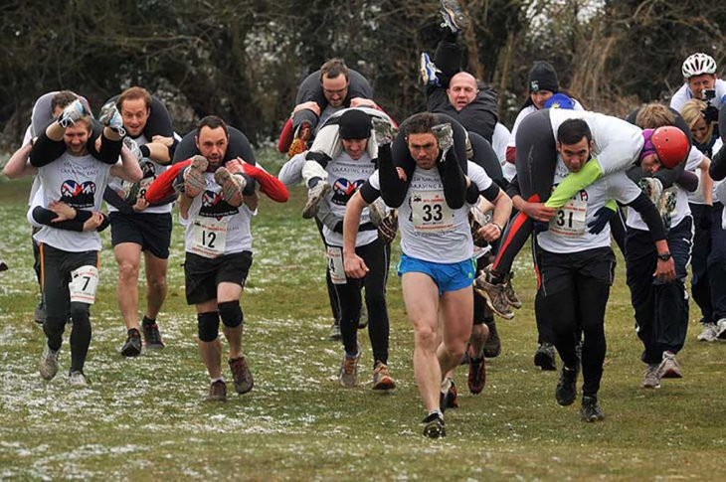
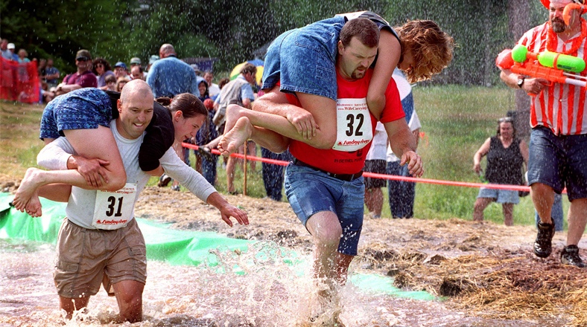
GIRLDFRIENDS RACE
This is a sport in which the participants (men) have to overcome a race of obstacles loaded with their wife in the shoulders. The one who completes the tour in the shortest possible time wins. The prize depends on the weight of the woman, as it equals her weight in the beer.

Slide 3
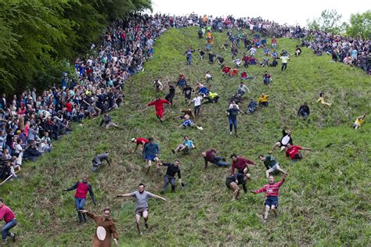
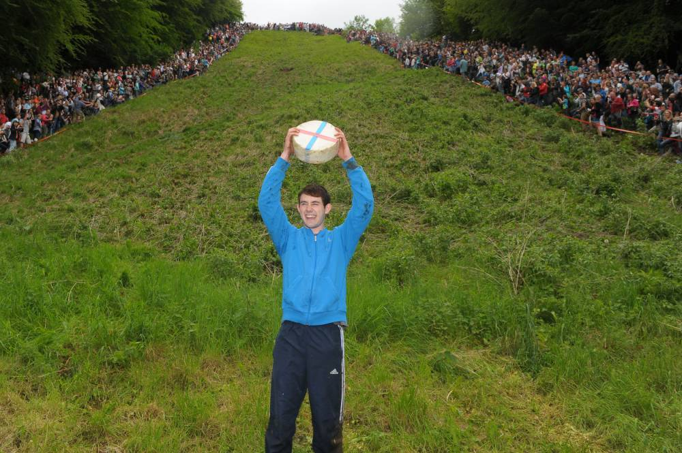
THE CHEESE ROLLING AND WAKE
This competition, called The Cheese rolling and wake, has centuries of history and the mechanics is very simple: it's about rolling down the mountain chasing a cheese. The first one who gets it wins. Hundreds of participants flock to Brockworth every year to be the new winner, but many of them finish the race with broken bones.

Slide 4
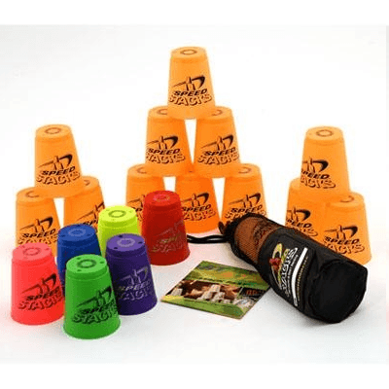
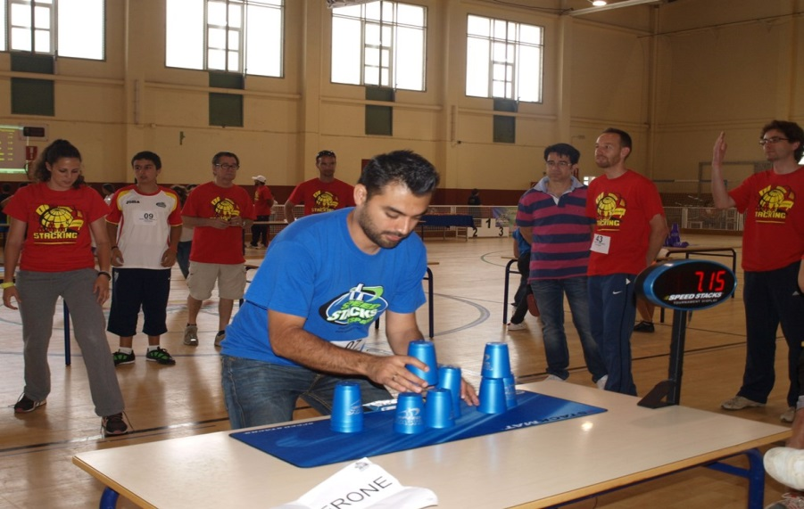
THE STACKING
The stacking was born in California and consists of stacking colored glasses at full speed, and then picking them up in another. There is currently a World league. It will seem silly, but it is shown to improve hand-eye coordination and reaction time at 30%.

Slide 5
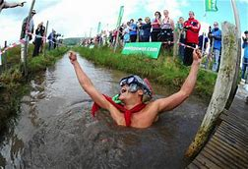
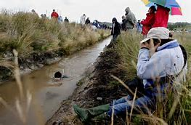
DIVING IN THE SWAMP
In the small town of Llanwrtyd Wells, after a drunken night, two men decided to swim in the local swamp, which is full of mud. Today, people from all over the world come to the swamp to practice their great idea. But there are some rules: swim, with your head in the water and with the help of fins and snorkel. The route is 110 meters long and 6 deep

Slide 6
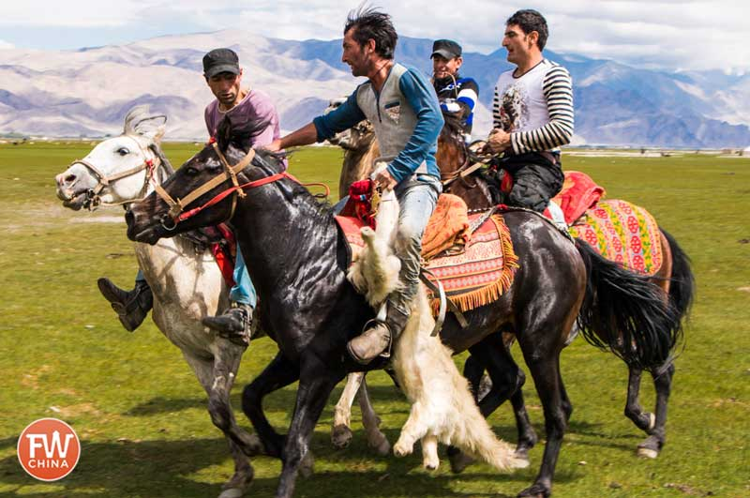
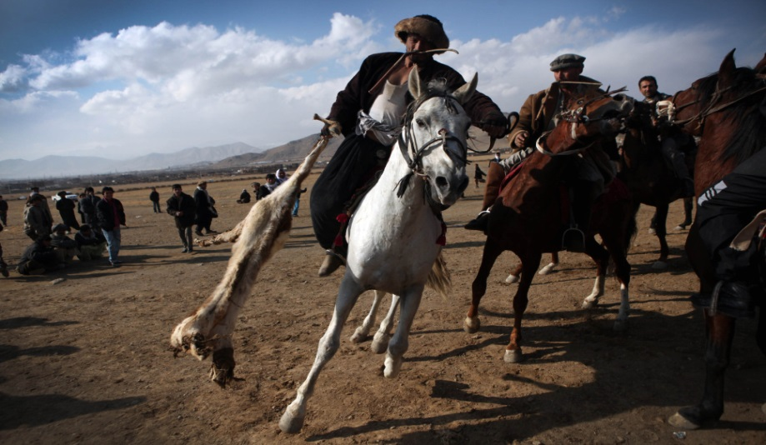
BUZKASHI
It is the national sport of Afghanistan and other Central Asian countries. Two teams of riders compete in a 2 km long field with the aim of driving the Boz (a goat without a head or limbs) from one end to the other. It's a very violent game, because there are no rules, and it usually ends up full of blood.

Slide 7
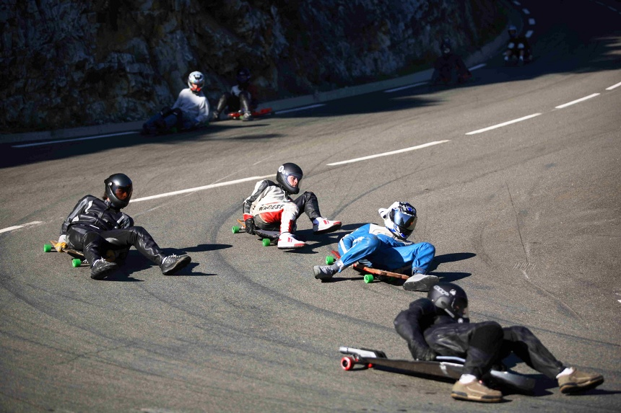
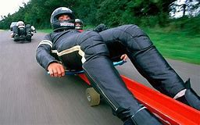
ASPHALT SLED
This is a high-risk sport. It is a sport that is practiced in the Olympic Winter Games. Each participant has a sled. The 100 kilometres are reached and the speed is controlled with the body. The feet are used to slow down. Now it is practiced all over the world.

Slide 8
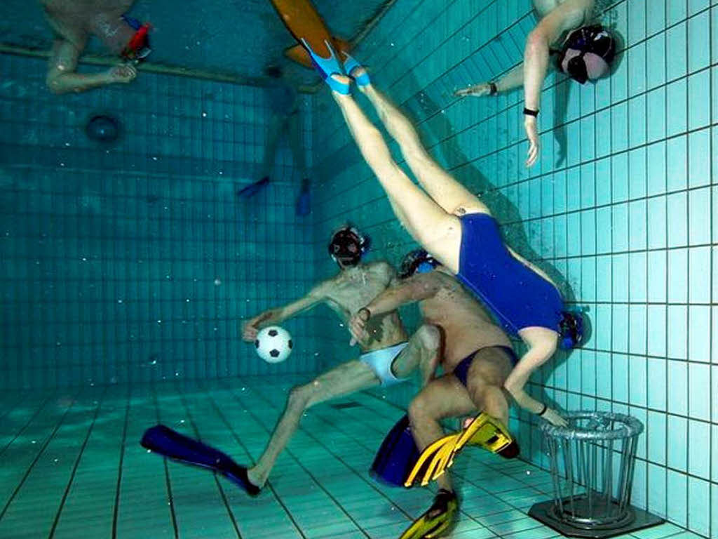
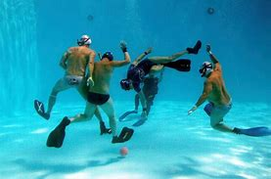
UNDERWATER RUGBY
It is played in a pool with a ball full of seawater and the players are 11. The players wear fins, oxygen tube and goggles. The goal is to put the ball in the basket of the opposing team, which is 4 meters deep.

Slide 9
HASHING
It's like football-volleyball. Two teams of three players, they pass a ball of cane using only the feet or the head. It is clear that the players have an impressive flexibility, because they make a very difficult posture.

