Slide 1
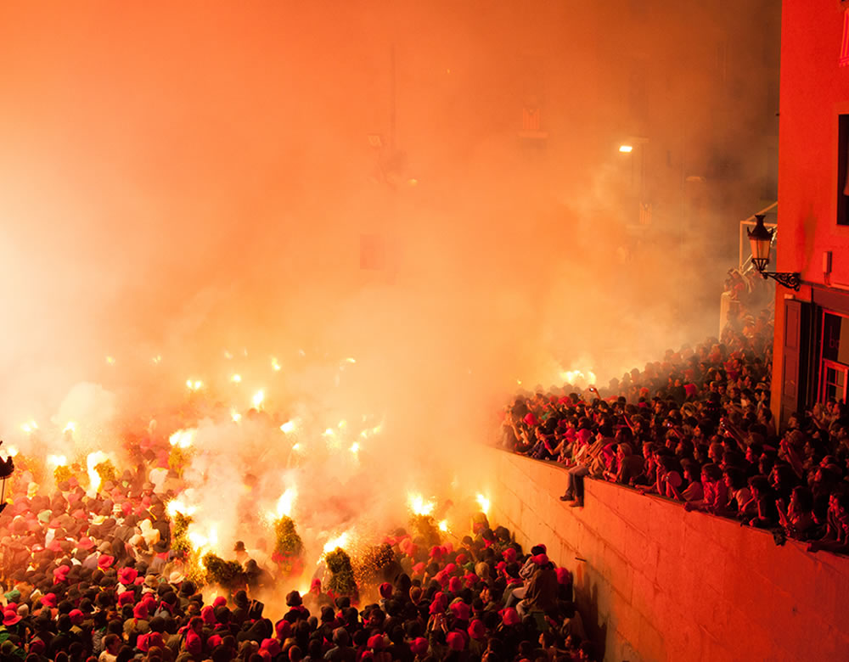
LA PATUM
Queralt Segura

Slide 2
LA PATUM
“La Patum” is a catalan tradition celebrated in Berga.
It consists of different representations on the street and with the citizen participation, which is characterized by the presence of fire, pyrotechnics and elements of religious origin.
In 1983 it was declared by the Generalitat de Catalunya “Festa patrimoni and d’interès nacional” and on November 25, 2005 was declared “Obra Mestra del Patrimoni Oral and Immaterial de la Humanitat” by UNESCO.

Slide 3
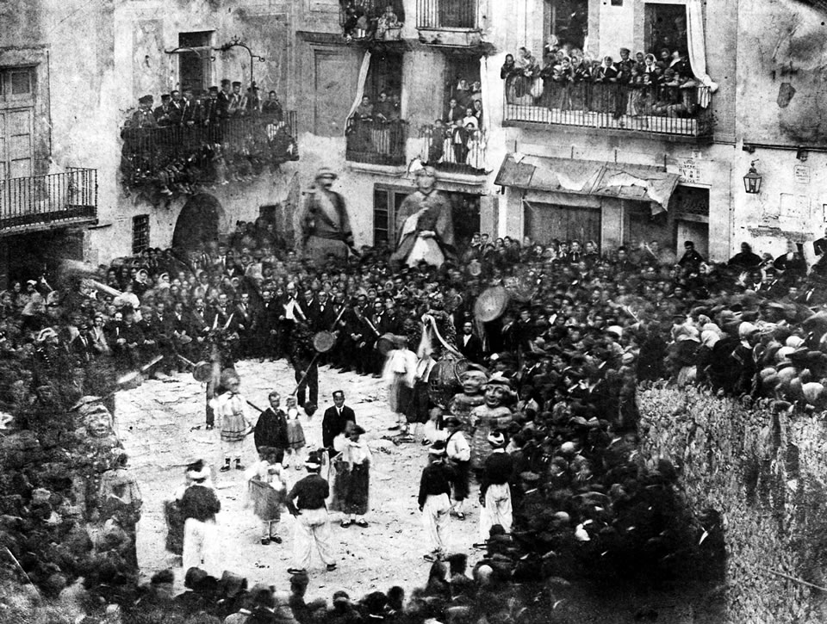
HISTORY
The old “entremesos” that marched past to the processions of Corpus Christi, they were destined to educate, to moralize and to offer the people so that it deepened in the knowledge of the “Sagradas Escriptures”.
Over time this educate activities they transformed to playful activities, this thing, that took place in several towns and cities of Catalonia, was extinguished as a result of the prohibitions promulgated by civil powers.
Only, a city called Berga has been able to maintain it and preserve it over the centuries. And it’s called Patum.

Slide 4
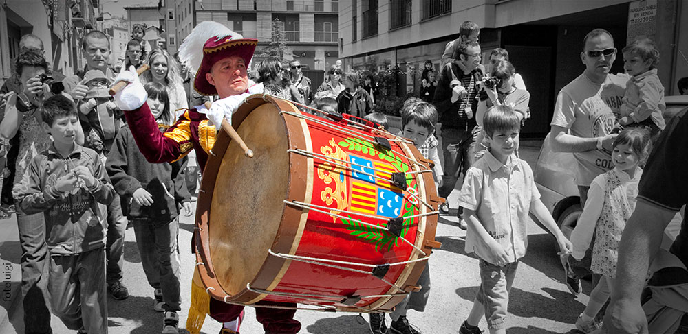
EL TABAL
Is not considered as a “comparsa”, it’s more considered as a musical instrument.
Documented from 1626, and rebuilt in 1726, it was the only instrument of La Patum, at the rate of which the “comparses” envolved, until the middle of the 17th century.
https://www.youtube.com/watch?v=MiuNNetUjdY

Slide 5
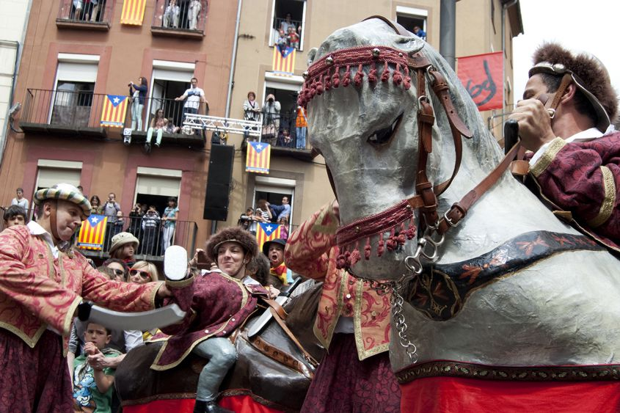
TURCS I CAVALLETS
Four Christian horsemen and four Turks by foot simulate a battle from which the first ones are always winners.
The first reference that we know the date is on 1628 and the actual figure it was built on 1890. In the same year they went from the sound of the Tabal to a music melody.
https://www.youtube.com/watch?v=DhnqGJfmZ6k (0,39)

Slide 6
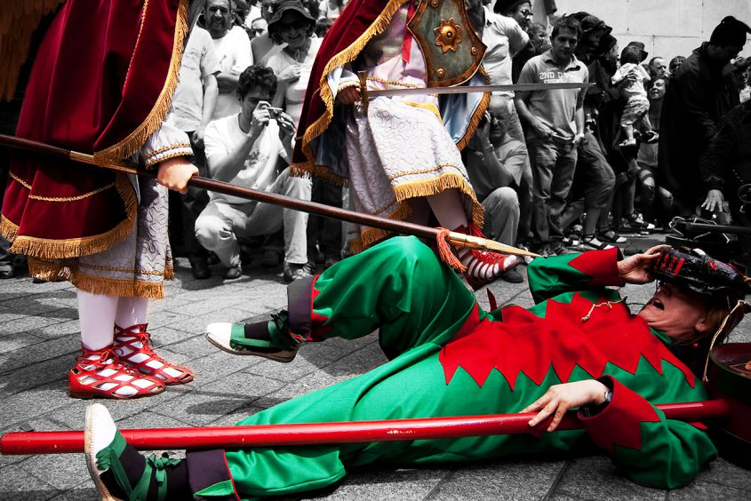
MACES
Also documented since 1628, symbolizes the eternal struggle between Good and Evil, represented here through the naive staging of a struggle between angels and demons.
They were the last figure that music is incorporated, but they only dance this music on “salts de lluïment” (at midday). On the other “jumps” they dace with the sound of Timbal.
https://www.youtube.com/watch?v=jcmexwOZ-MA (0,12)

Slide 7
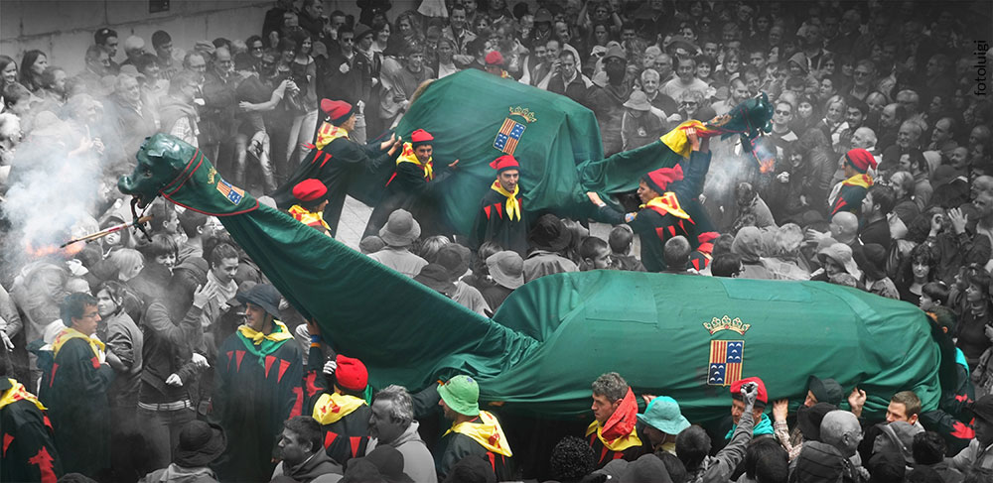
LA GUITA
Is a figure with mule body, a horsetail, a giraffe’s neck and a dragons head, and is one of the oldest elements of the celebration.
And there is two “Guites” the big one (It was the first) and then appear the small one.
They dace with the sound of “Timbal”.
https://www.youtube.com/watch?v=3pLNQKmF9hw

Slide 8
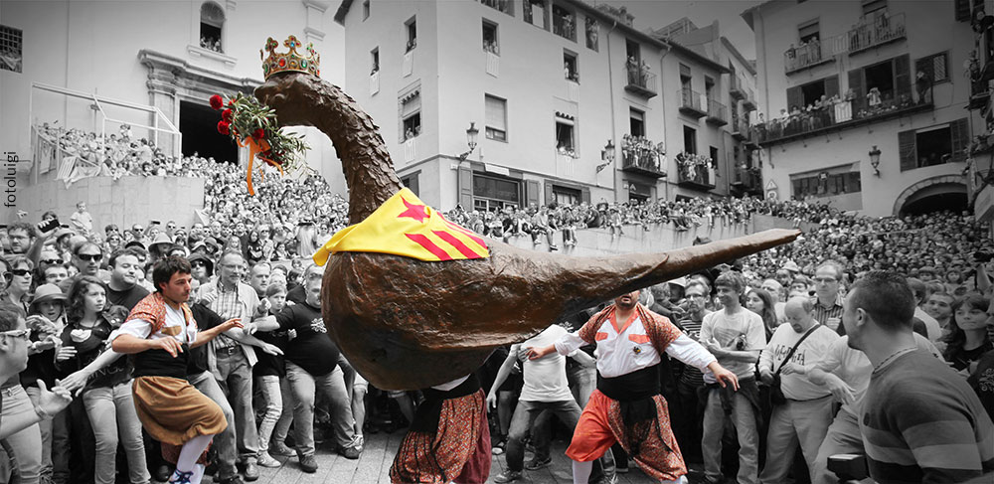
L’ÀLIGA
In 1756 the City Council of Berga decided to incorporate an “Eagle (Àliga)”.
The music is the most distinguishable and monumental.
https://www.youtube.com/watch?v=TV4KWEXkeT4

Slide 9
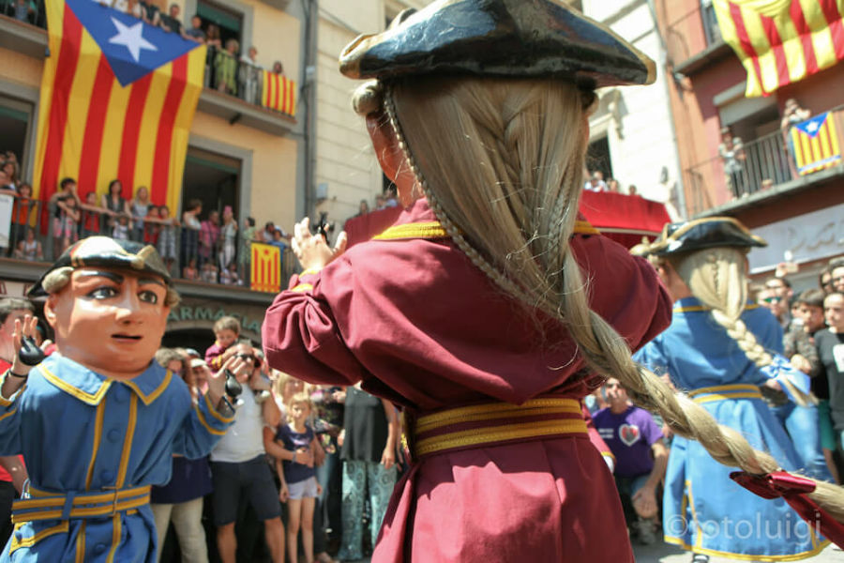
ELS NANS VELLS
There are four figures, with a peculiar hat and long wigs, they dance playing the castanets accompanied with a popular melody.
They were a donation from Ferran Moragues.
https://www.youtube.com/watch?v=kT3LemEylFw

Slide 10
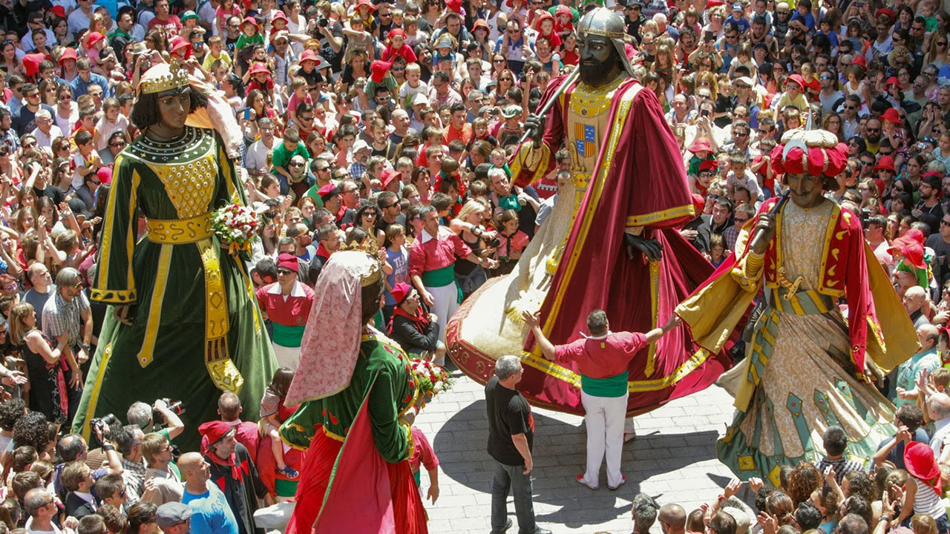
ELS GEGANTS
They were documented on 1695. Actually there are two couples the old ones (Els Vells) and the new ones (Els Nous).
Their dances are, normally, adaptations of Catalan popular melodies.
https://www.youtube.com/watch?v=A7KplNv3aYo

Slide 11
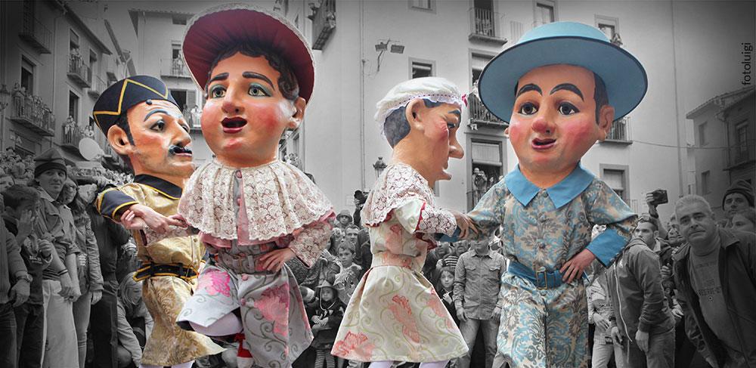
ELS NANS NOUS
They were used for the first time on 1890 for replace the old ones (they was broken). But they repaired the old ones.
The “Nans Nous” are two couples. One young couple and the other old couple, they dace a happy melody. This song is the most popular song of the Patum.
https://www.youtube.com/watch?v=yAdEMuUgqRo

Slide 12
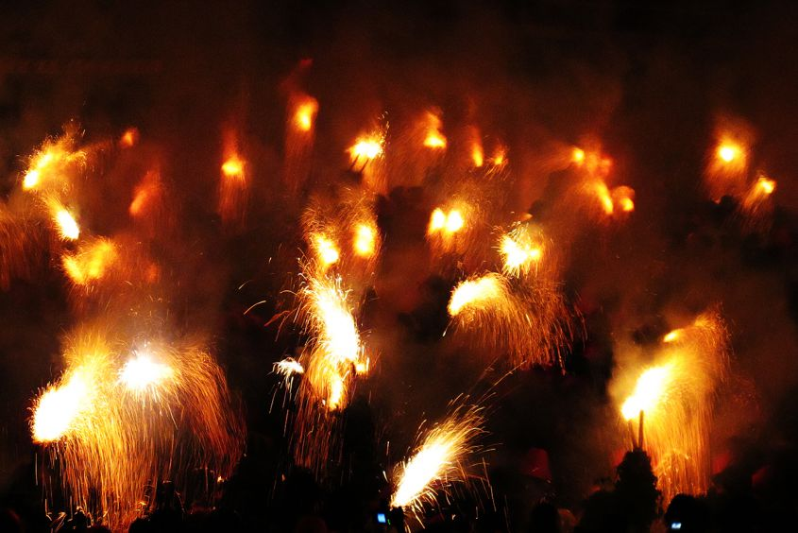
ELS PLENS
They are the biggest performance of Patum, they were documented on 1628. When the light goes off, the music starts and the square is full of smoke and fire.
First they only danced with the sound of Tabal and then Quimserra composed a music.
https://www.youtube.com/watch?v=V9HhPEKDLZM

Slide 13
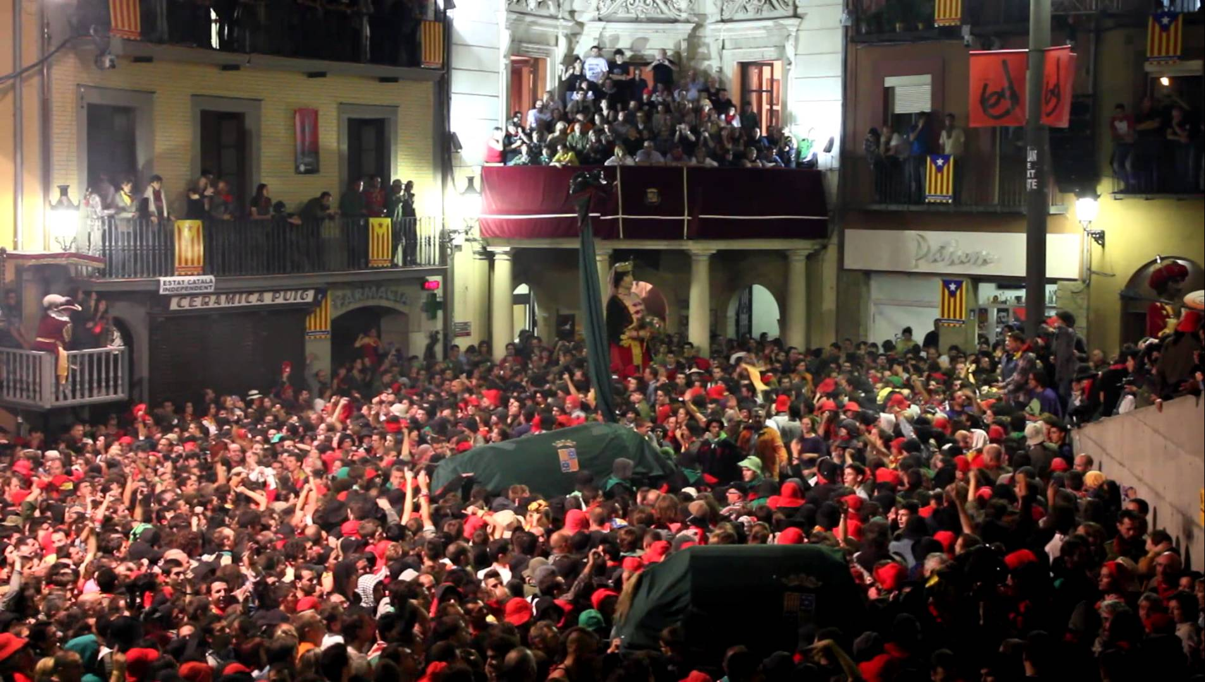
EL TIRABOL
El Tirabol is not considered as a “comparsa”. It represents the end of la Patum.
The “Gegants” and the “Guites” dance there, with the “Tabal” and music melody.
https://www.youtube.com/watch?v=Vi5OnyychYc

Slide 14
THE END

